Slide 1
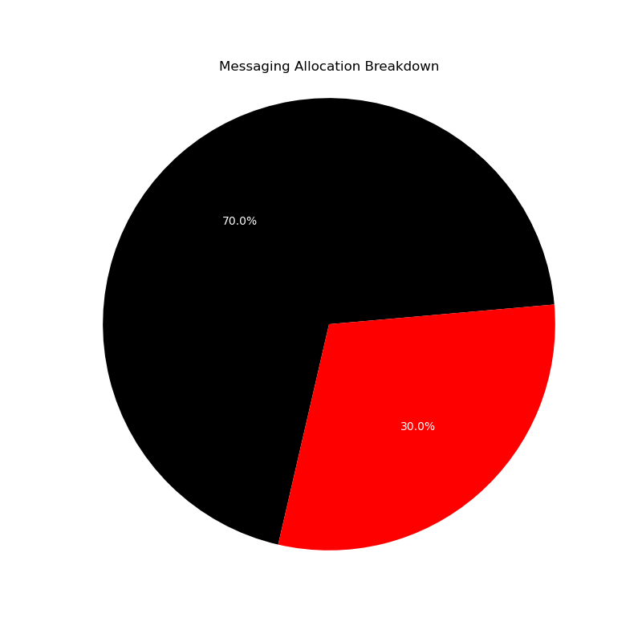
Promotional Messaging Strategy Recommendation for 23-24 Season Opener
The marketing team has a quota of 500 messages to produce fan engagement for the upcoming season opener. I analyzed the data provided from the 2022-23 season and was able to extract several key insights. But before we dive into the messaging allocation, we must consider two questions:
1. What customer segment led to the highest spending amount?
2. Where is there room to grow and expand engagement in lower customer segments?
Ideal customer segment for game attendance and revenue:
- Fans going to 10 or more games
- Fans with an income of $250,000 or more
- Fans in the age range of 45-54
- Living in these zip codes: 77461, 77565, 77498
Allocation Strategy for the 500-Messaging Quota
Ideal customer segments for expanding smaller markets:
- Fans going to 10 or less games
- Fans with an income between $150,000 - $249,999 and lower
- Fans in the age range of 55-64 and younger than 34
- Fans with a High School diploma or equivalent
- Females with a family of 3+ children
- Living in these zip codes: 77069, 77030, 77532, 77036
Big Spenders and Loyal Fans
- Allocate approximately 70% of messages (350) to fans who attended 10 or more games in the 2022-23 season.
- Allocate 60% (300) to fans with incomes of $100,000 - $150,000 and $250,000+
- We’ll also allocate 100 of the 350 “10+ game” messages to an age group that showed the most attendance. See next slide for more insights
.
Smaller Market Expansion
- Allocate the remaining 30% of messages (150) to fans who attended 10 or less games.
- Diversify these 150 messages by targeting fans across various income ranges, specifically fans with incomes under $100,000.
- Expand the age group to include a wider range of fans, specifically those 35 or younger.

Slide 2
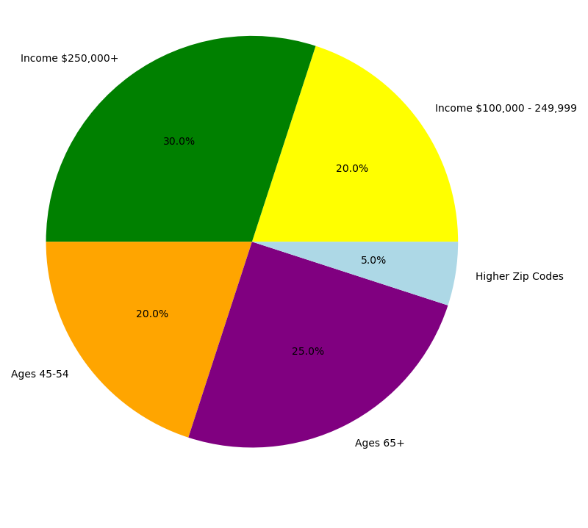
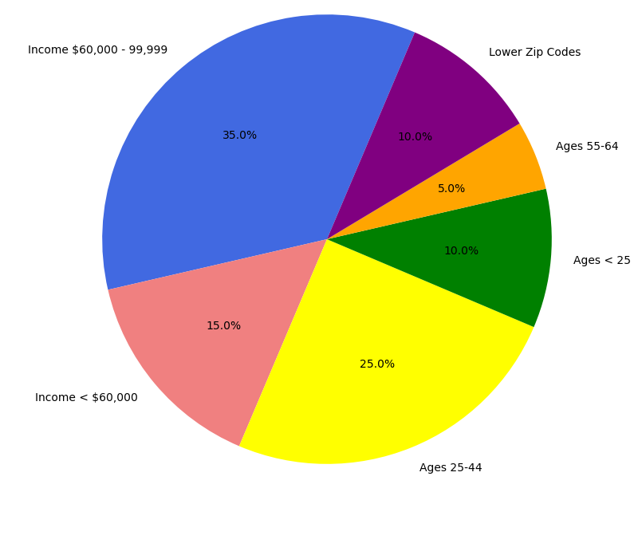
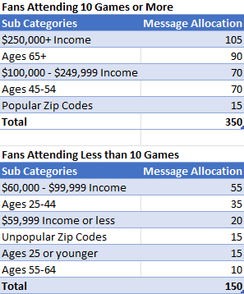
Messaging Allocation for Fans Attending 10 or more Games (350)
Messaging Allocation for Fans Attending 10 or less Games (150)
Allocation Breakdown
Digital Channel Methods
For sending messages, we will want to utilize Twitter (X) and Facebook as our primary platforms.
The data showed 1542 users followed the Rockets on Twitter and 1541 on Facebook.
Compared to 1498 for Instagram and 1451 for the mobile app
That’s a ratio of 1.043 higher for Twitter and Facebook than other digital channels.
The average fan followed the Rockets on ~2 platforms.
Fans who attended 10 or more games made up a massive portion of the overall spending for the 2022-23 season.
These fans had higher retail purchases and spending, making them a lucrative target. Spending ~$1,000 more than the average fan.
Prioritizing fans with higher incomes is crucial, as they have a stronger spending capacity.
Fans with an income of $250,000+ attended the most games last season, therefore spending the most.
Target fans aged 45-54 or 65 or older, as they showed a higher attendance.
Fans who attended 10 or less games are significant for increasing fan engagement. While their individual spending may be lower, there’s a larger group to target.
It’s important to include fans of all income ranges to help grow the fanbase, including those who make less than $99,999.
Expand the age group target to include a wider range of potential new fans.
Fans 18-34 showed to be the lowest age range for attendance in the 2022-2023 season. But they have a higher potential to become lifelong fans.
Insights:
In addition to the above information, we found that gender (Males = 1523 | Females = 1477) and education did not play a massive role regarding fan attendance and spending. The same goes for # of children per fan. Although more children would equate to more spending, we saw more attendance from fans with 0 kids (albeit by small margins).

